Slide 1


AI-Powered Data Query Interface
This presentation outlines a comprehensive project for building an AI-powered data query interface using LangChain and MongoDB.
The presentation covers key aspects, including the problem statement, solution, architecture, implementation, demo, and more. You can use this guide to create slides using PowerPoint, Google Slides, or any other presentation tool.
By Team Straw-Hats

Slide 2

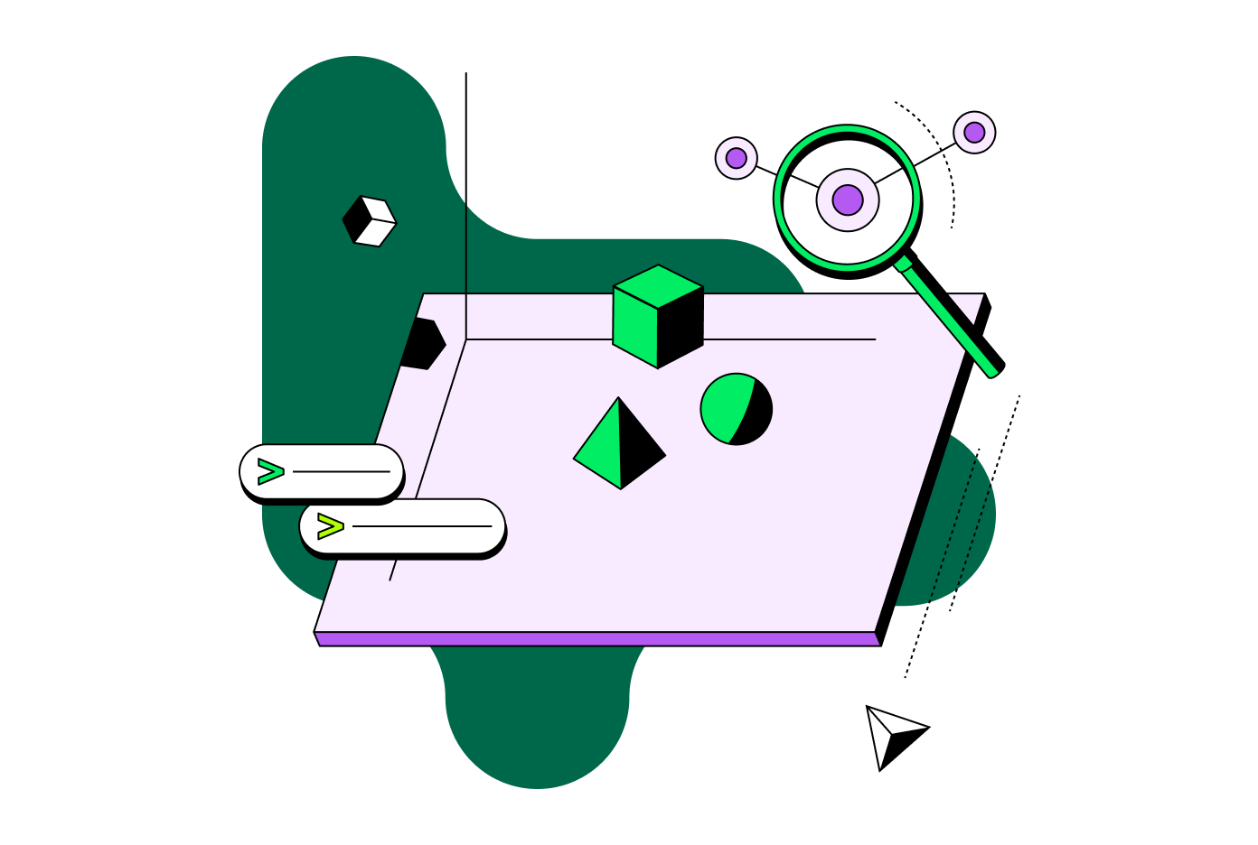
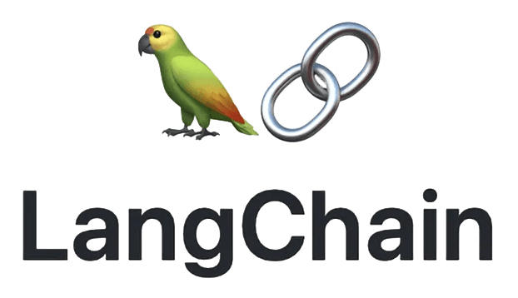
AI-Powered Data Query Interface
Leveraging LangChain and MongoDB for Natural Language Data Queries
This presentation outlines a comprehensive project for building an AI-powered data query interface using LangChain and MongoDB.

Slide 3

Problem Statement
Accessing and querying large datasets can be challenging for users without technical expertise. Traditional querying methods often require knowledge of database languages, such as SQL or MongoDB queries. This creates a barrier for non-technical users who need to interact with data.
There is a need for a more intuitive and user-friendly way to access and query data. This would enable a wider range of users to leverage the insights and value contained within large datasets.

Slide 4
Solution Overview
LangChain
AI-Powered Data Query Interface
LangChain provides natural language understanding and query generation capabilities. It translates user queries into structured database queries, enabling seamless interaction with the data.
This interface allows users to query data using natural language. It eliminates the need for technical expertise in database languages, making data access more accessible.
MongoDB
User-Friendly Interface
MongoDB serves as the efficient storage and retrieval system for large datasets. Its flexible schema and scalability ensure smooth data handling and performance.
The interface simplifies interaction with the database through a chat-like experience. Users can easily ask questions and receive relevant data without needing to learn complex query languages.

Slide 5
System Architecture
Frontend: A chat interface for user interaction, built using React.js/Vue.js.
Backend: LangChain for natural language processing, FastAPI for API management, and PyMongo for database interaction.
Database: MongoDB for data storage.
Deployment: Dockerized services and cloud deployment for scalability.

Slide 6
Key Technologies
LangChain
MongoDB
React.js/Vue.js
FastAPI
LangChain converts natural language queries to MongoDB queries. This allows users to interact with the database using plain English, eliminating the need for technical expertise in database languages.
MongoDB is a NoSQL database that provides flexible data storage. It allows for unstructured data and dynamic schemas, making it ideal for handling complex and evolving datasets.
React.js and Vue.js are popular frontend frameworks used for building interactive user interfaces. They provide a robust foundation for creating engaging and responsive web applications.
FastAPI is a modern, high-performance web framework for building APIs with Python. It offers features like automatic documentation, data validation, and asynchronous programming, etc.

Slide 7
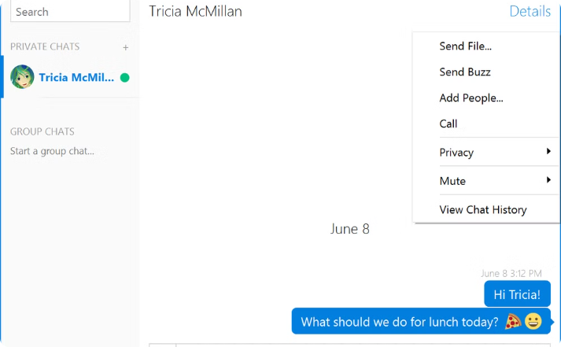
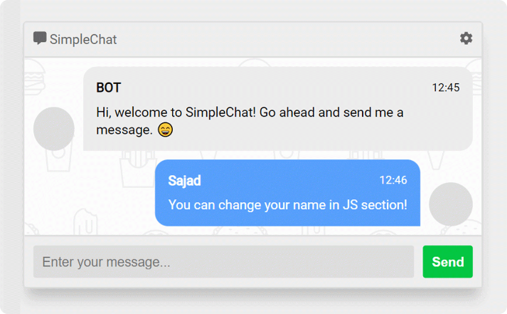
Frontend Implementation
Chat Window
Input Box and Submit Button
The chat window displays the conversation history, allowing users to track their interactions with the AI-powered query interface. This provides context and transparency for users, enabling them to understand the flow of their queries and responses.
The input box allows users to enter their natural language queries. The submit button triggers the query process, sending the user's input to the backend for processing and data retrieval.

Slide 8
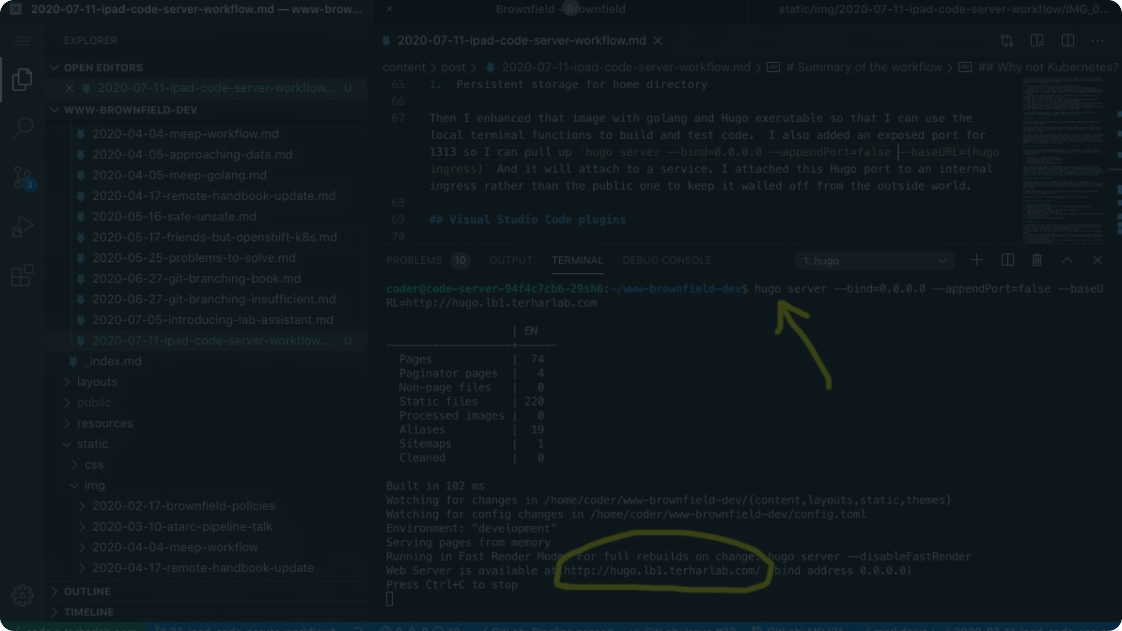
Backend Implementation
The backend implementation is built using LangChain and FastAPI. LangChain is responsible for converting natural language queries into structured MongoDB queries. This involves a simple NLP pipeline that analyzes the user's input and translates it into a format that MongoDB can understand.
FastAPI serves as the API gateway, handling incoming requests from the frontend and connecting LangChain to MongoDB. It ensures smooth communication between the user interface and the database, enabling efficient data retrieval and processing.

Slide 9
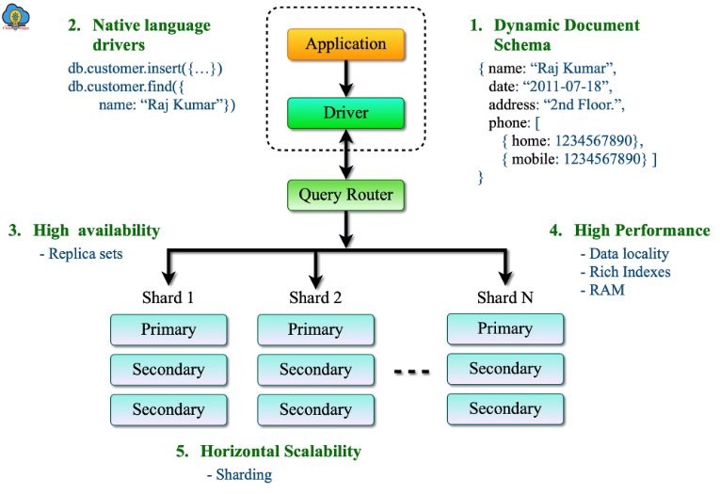
Database Implementation
MongoDB
MongoDB is a NoSQL database that stores data for efficient querying. It handles large datasets and complex queries. MongoDB is a popular choice for applications that require flexibility and scalability. It allows for unstructured data and dynamic schemas, making it ideal for handling complex and evolving datasets.

Slide 10

Demo Examples
1
2
3
Scenario 1
Scenario 2
Scenario 3
This scenario demonstrates querying for clients located in New York. The user will input a natural language query such as "Show me clients in New York." The AI-powered interface will translate this query into a structured MongoDB query and retrieve the relevant client data.
This scenario showcases querying for the total revenue generated by a specific client. The user can input a query like "What is the total revenue from Acme Corporation?" The system will process the query and return the aggregated revenue data for the specified client.
This scenario demonstrates querying for recent transactions. The user can input a query such as "Show me transactions from the last week." The system will process the query and retrieve the relevant transaction data from the specified time period.

Slide 11
Advanced Features
Optional Enhancements
The system offers several advanced features to enhance the user experience and expand its capabilities:
Complex Queries: The interface can handle queries with multiple conditions, enabling users to perform more sophisticated data searches and retrieve targeted information.
Context-Aware Responses: The system can understand follow-up queries and provide responses that are tailored to the user's specific context, improving the overall conversational flow.
Visualizations: Users can generate charts and graphs to visually represent the data, facilitating better understanding and analysis of the retrieved information.
Voice Interaction: The system supports speech-to-text and text-to-speech functionality, allowing users to interact with the interface using voice commands and receive auditory responses.
Integration: The system can integrate with CRM systems and BI tools, enabling seamless data exchange and enhanced decision-making capabilities.

Slide 12
Conclusion
Key Takeaways:
Summary:
Developing an intuitive AI-powered interface for natural language data querying.
Integration of LangChain for advanced NLP capabilities and MongoDB for flexible data storage.
Demonstrated the system's efficiency and ease of use.
Impact:
Enhances data accessibility and usability for non-technical users.
Empowers improved decision-making by enabling more seamless data interaction.

Slide 13
Thank You
We would like to express our heartfelt gratitude to all those who have supported us throughout this journey. Your contributions, whether through mentorship, organization, or simply your presence, have been invaluable.
To our esteemed team members, we thank you for your tireless efforts and unwavering dedication. Your expertise and collaborative spirit have been instrumental in making this project a success.
Contact Information
Team Member: Abhay Rawat (Leader)
Email addresses: abhay892rawat@gmail.com
Team Member: Saubhagya Singh
Email addresses: 12113026@nitkkr.ac.in
Team Member: Savya Sachi
Email addresses: savyas02@gmail.com
Acknowledgments
Hackathon organizers: Woodpecker Analytics and Services Private Limited

